Slide 1

Multi-arm Bandits, Applications and Contextual Bandits
Surya Prakash G
DRL Team
BITS Pilani WILP

Slide 2
Agenda
Motivation
K-arm Bandit problem
Exploration and exploitation
Action Value methods
Update rule for single action; simple Bandit algorithm
Update rule in non-stationary context
Bias problem -Concept of Optimistic Initial Values
Upper confidence Bound Action Selection
Contextual Bandits

Slide 3
Motivation
Real-world systems –we must choose among several options without knowing their outcomes in advance
Each option may produce different rewards, but the reward distributions are unknown initially.
Agent must learn which option is best while making the choices
k-Bandit problem is an abstract model to understand the concept of decision making under uncertainity
Use cases
Online Advertising
Recommendation systems
Clinical trials –allocate different patients to different trials

Slide 4
K-arm Bandit Problem
Core Idea
An Agent repeatedly selects one action among K alternatives
Each action produces an uncertain reward
Reward distributions are un-known
Learning occurs through interaction

Slide 5
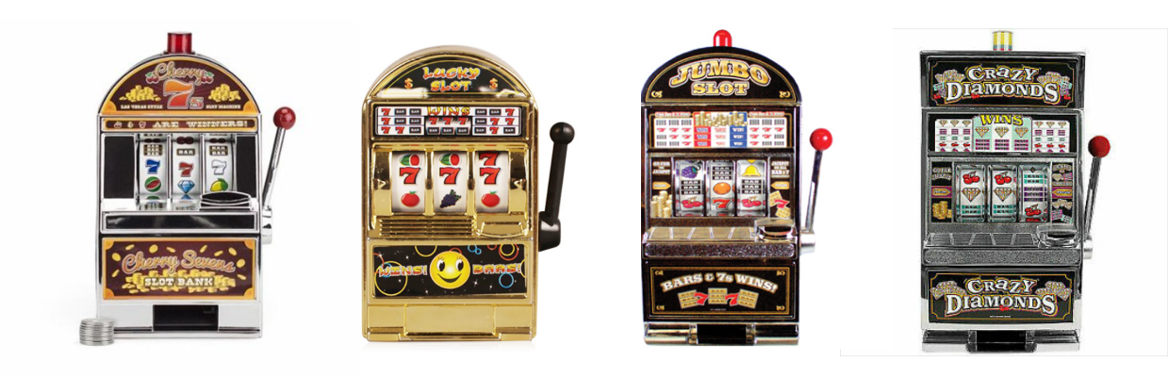
K-arm Bandit Problem
Problem
You are faced repeatedly with a choice among k different options, or actions
After each choice of actions, you receive a numerical reward
Reward is chosen from a stationary probability distribution that depends on the selected action
Objective : To maximize the expected total reward over some time period

Slide 6
K-arm Bandit Problem
Problem
You are faced repeatedly with a choice among k different options, or actions
After each choice of actions, you receive a numerical reward
Reward is chosen from a stationary probability distribution that depends on the selected action
Objective : To maximize the expected total reward over some time period
Strategy:
Identify the best lever(s)
Keep pulling the identified ones
Questions:
How do we define the best ones?
What are the best levers?

Slide 7
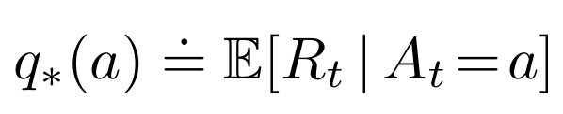
K-arm Bandit Problem
Problem
You are faced repeatedly with a choice among k different options, or actions
After each choice of actions, you receive a numerical reward
Reward is chosen from a stationary probability distribution that depends on the selected action
Objective : To maximize the expected total reward over some time period
Expected Mean Reward for each action selected
→ call it Value of the action

Slide 8
K-armed Bandit Problem
A_{t} - action selected on time step t
Q_{t} (a) - estimated value of action a at time step t
q*(a) - value of an arbitrary action a
Note: If you knew the value of each action, then it would be trivial to solve the k -armed bandit problem: you would always select the action with highest value :-)

Slide 9
K-armed Bandit Problem

Slide 10
K-armed Bandit Problem
Keep pulling the levers; update the estimate of action values;

Slide 11
K-armed Bandit Problem

Slide 12
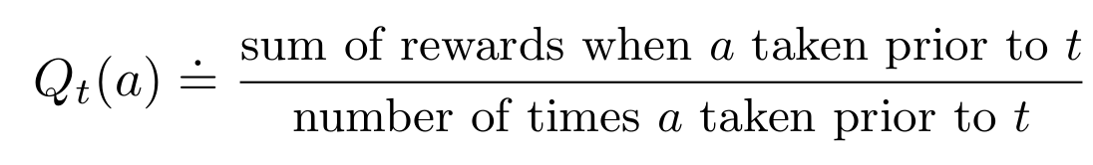
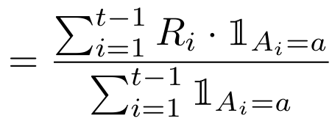
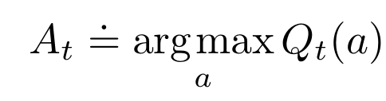
K-armed Bandit Problem
How to maintain the estimate of expected rewards for each action?
Average the rewards actually received !!!
How to use the estimate in selecting the right action?
Greedy Action Selection

Slide 13
K-armed Bandit Problem
2. How to use the estimate in selecting the right action?
Greedy Action Selection
3. Exploration vs. Exploitation?
ε-Greedy Action Selection / near-greedy action selection
Behave greedily most of the time; Once in a while, with small probability 𝛆 select randomly from among all the actions with equal probability, independently of the action-value estimates.
Actions which are inferior by the value estimate upto time t, could be indeed better than the greedy action at t !!!

Slide 14
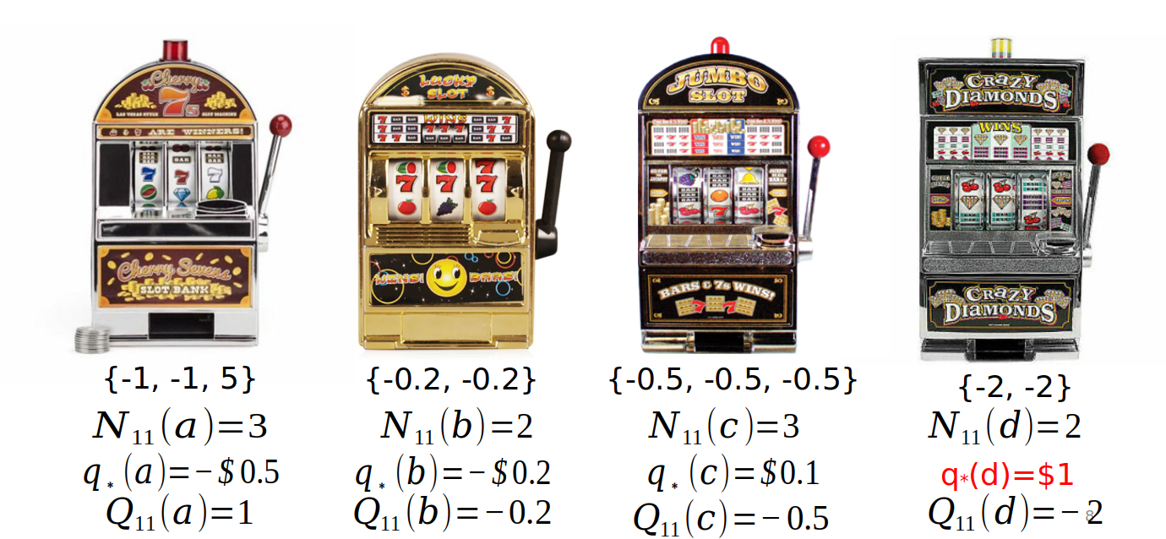
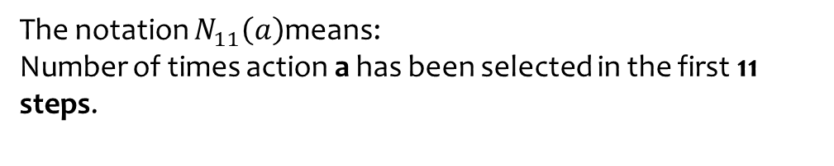
K-armed Bandit Problem
The notation $N_{11}\left(a\right)$means:
Number of times action a has been selected in the first 11 steps.
The slide shows a K-armed bandit with four slot machines:

Slide 15
K-armed Bandit Problem
q*: true action value or true expected reward of the machine
The slide shows a K-armed bandit with four slot machines:

Slide 16
K-armed Bandit Problem
The slide shows a K-armed bandit with four slot machines:
Greedy Action

Slide 17
K-armed Bandit Problem
Action to Explore
The slide shows a K-armed bandit with four slot machines:

Slide 18
Exploration vs Exploitation
Exploration: Try un-known options and gain knowledge (experience)
Exploitation: Choose the best –known action and gain immediate reward
Central Dilemma: Short term reward vs long term learning
Difference between Traditional ML and Bandits
Adaptive systems such as
Advertisement optimization
Dynamic Pricing
Machine learning | Bandits
Static dataset | Online interaction
Full Feedback | Partial Feedback
Predict Labels | Make Decisions
Ofline training | Continuous learning

Slide 19
K-armed Bandit Problem: ε-Greedy
ε-Greedy Action Selection / near-greedy action selection
epsilon = 0.05 // small value to control exploration
def get_action():
if random.random() > epsilon:
return argmaxa(Q(a))
else:
return random.choice(A)
In the limit as the number of steps increases, every action will be sampled by ε-greedy action selection an infinite number of times. This ensures that all the Qt (a) converge to q* (a).
Easy to implement / optimize for epsilon / yields good results

Slide 20
Ex-1: In ε-greedy action selection, for the case of two actions and ε = 0.5, what is the probability that the greedy action is selected?
Example
Notes:
Refer to https://ai.stackexchange.com/questions/27931/what-is-the-probability-of-selecting-the-greedy-action-in-a-0-5-greedy-selection
for a good discussion on the solution.

Slide 21
Ex-1: In ε-greedy action selection, for the case of two actions and ε = 0.5, what is the probability that the greedy action is selected?
p (greedy action)
= p (greedy action AND greedy selection ) + p (greedy action AND random selection )
= p (greedy action | greedy selection ) p ( greedy selection )
+ p (greedy action | random selection ) p (random selection )
= p (greedy action | greedy selection ) (1-𝛆) + p (greedy action | random selection ) (𝛆)
= p (greedy action | greedy selection ) (0.5) + p (greedy action | random selection ) (0.5)
= (1) (0.5) + (0.5) (0.5)
= 0.5 + 0.25
= 0.75
Notes:
Refer to https://ai.stackexchange.com/questions/27931/what-is-the-probability-of-selecting-the-greedy-action-in-a-0-5-greedy-selection
for a good discussion on the solution.

Slide 22

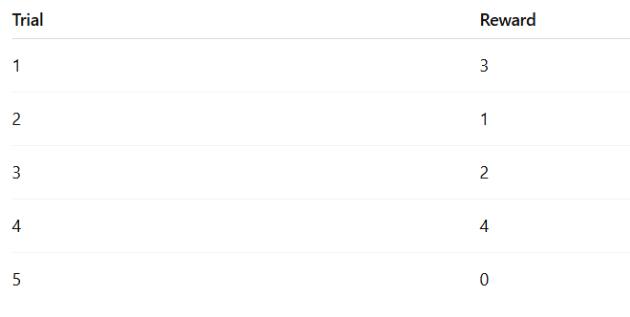
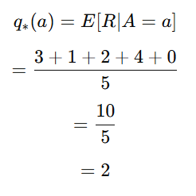
Action Value Method
True value is given by:

Slide 23
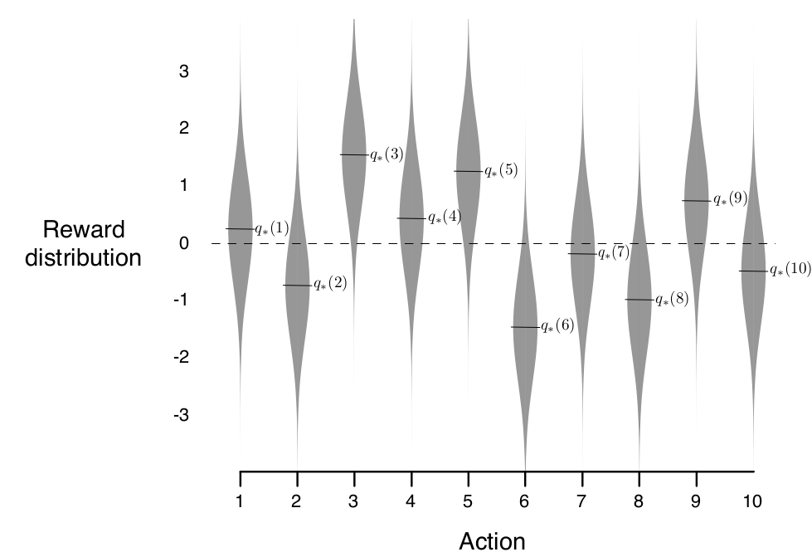
10-armed Testbed
Example:
A set of 2000 randomly generated k -armed bandit problems with k = 10
Action values were selected according to a normal (Gaussian) distribution with mean 0 and variance 1.
While selecting action A_{t} at time step t, the actual reward, R_{t} , was selected from a normal distribution with mean q*(At ) and variance 1
One Run : Apply a method for 1000 time-steps to one of the bandit problems
Perform 2000 runs, each run with a different bandit problem, to get an algorithms average behavior
An example bandit problem from the 10-armed testbed

Slide 24
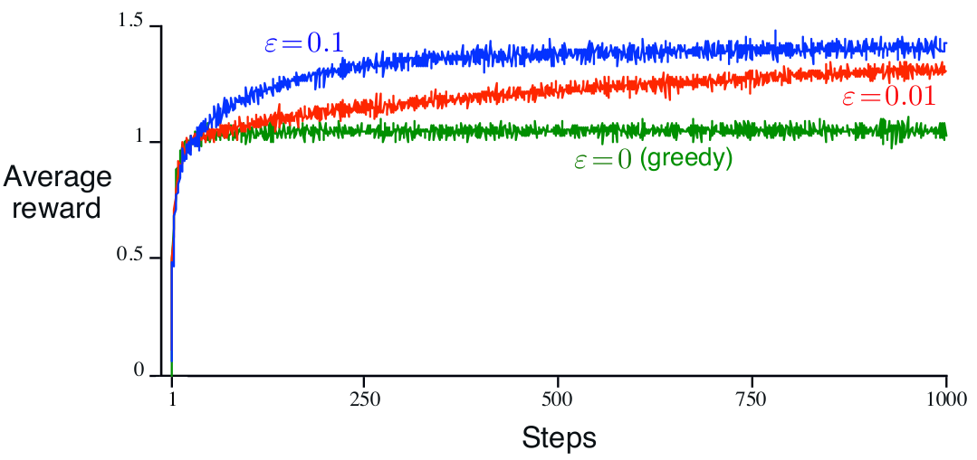
𝛆-greedy action-value methods on the 10-armed testbed

Slide 25
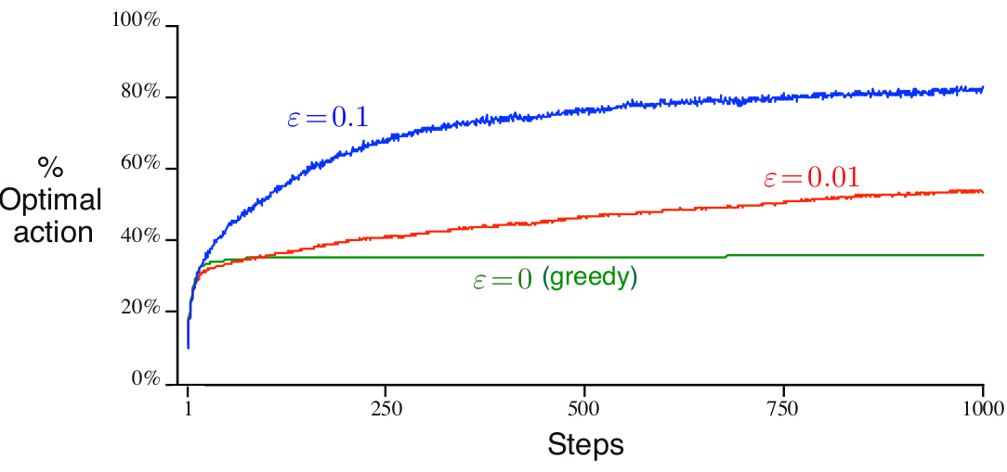
𝛆-greedy action-value methods on the 10-armed testbed

Slide 26
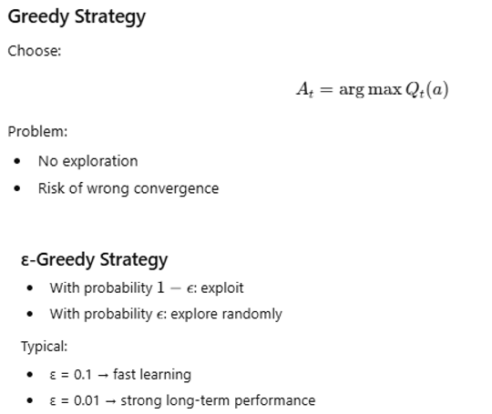
Summary: Greedy vs 𝛆-greedy

Slide 27
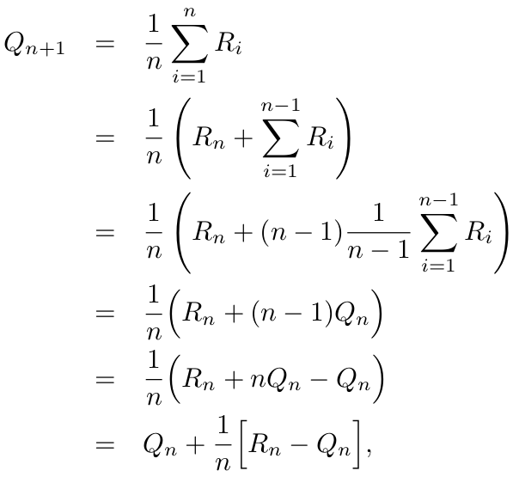

Incremental Implementation
Efficient approach to compute the estimate of action-value;
Given Qn and the nth reward, Rn , the new average of all n rewards can be computed as follows

Slide 28
Incremental Implementation
Note:
StepSize decreases with each update
We use 𝛂 or 𝛂_{t}(a) to denote step size (constant / varies with each step)
Discussion:
Const vs. Variable step size?

Slide 29
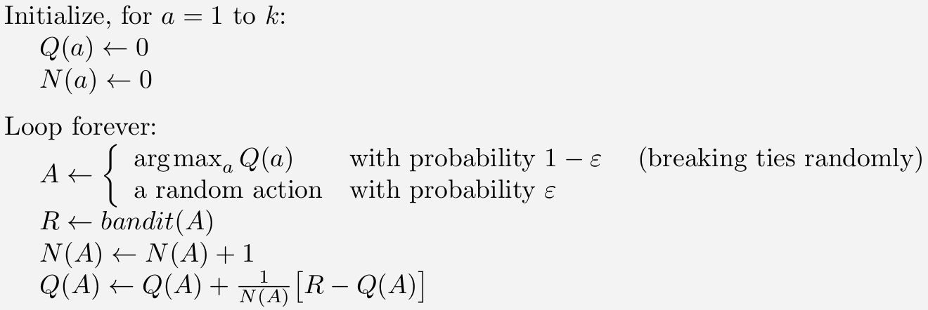
Incremental Update/ 𝛆-greedy selection

Slide 30
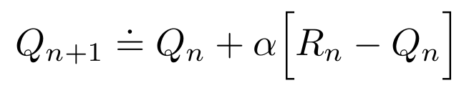
Non-stationary Problem
Most RL problems are non-stationary !
Give more weight to recent rewards than to long-past rewards !!!

Slide 31
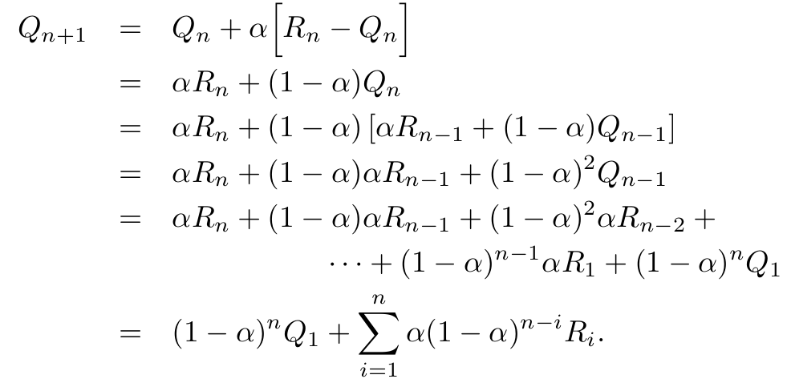
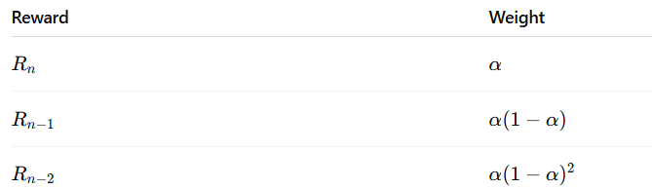
Non-stationary Problem
Most RL problems are non-stationary !
Give more weight to recent rewards than to long-past rewards !!!
Examples:
Seasonality, Market conditions over time
Shift of customer preferences over time
Exponential recency-weighted average
Notes:
Averaging methods are appropriate for stationary bandit problems,
We often encounter reinforcement learning problems that are effectively nonstationary; In such cases it makes sense to give more weight to recent rewards than to long-past rewards.

Slide 32
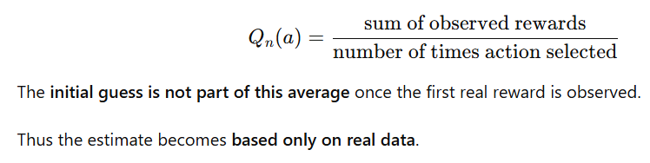
Optimistic Initial Values
All the above discussed ﻿methods are biased by their initial estimates
For sample average method ﻿the bias disappears once all actions have been selected at least once
For methods with constant α, the bias is permanent, though decreasing over time
﻿Initial action values can also be used as a simple way of encouraging exploration.

Slide 33
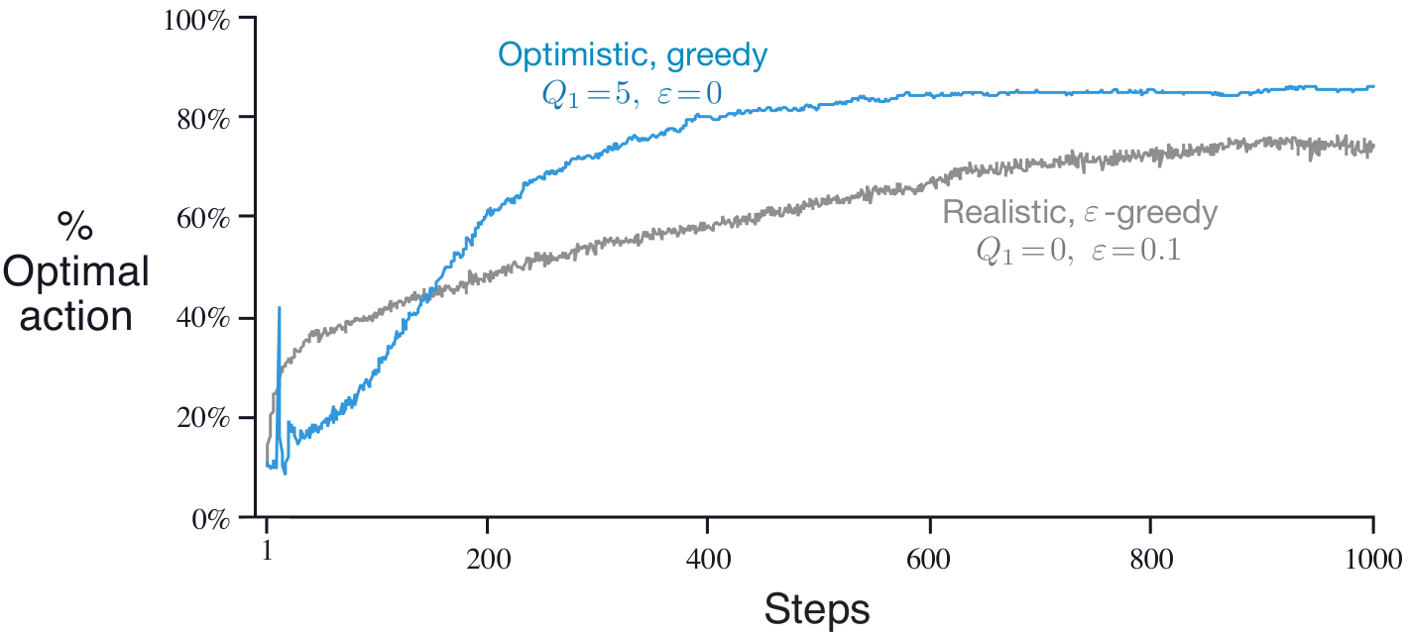
Optimistic Initial Values
Caution:
Optimistic Initial Values can only be considered as a simple trick that can be quite effective on stationary problems, but it is far from being a generally useful approach to encouraging exploration.
Question:
Explain how in the non-stationary scenario the optimistic initial values will fail (to explore adequately).
The effect of optimistic initial action-value estimates on the 10-armed testbed.
Both methods used a constant step-size parameter, 𝛂 = 0.1

Slide 34
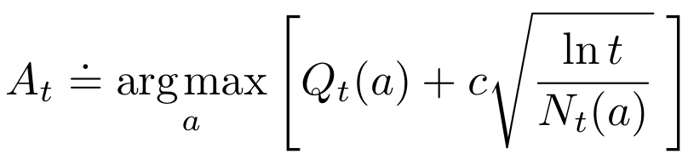
Upper-Confidence-Bound Action Selection
𝛆-greedy action selection forces the non-greedy actions to be tried,
Indiscriminately, with no preference for those that are nearly greedy or particularly uncertain
It would be better to select among the non-greedy actions according to their potential for actually being optimal
Take into account both how close their estimates are to being maximal and the uncertainties
in those estimates.

Slide 35
Upper-Confidence-Bound Action Selection
Each time a is selected the uncertainty is presumably reduced
Each time an action other than a is selected, t increases but N_{t}(a) does not; because t appears in the numerator, the uncertainty estimate increases.
Actions with lower value estimates, or that have already been selected frequently, will be selected with decreasing frequency over time
Confidence Level
Action Value at time t for a
Measure of Uncertainty

Slide 36
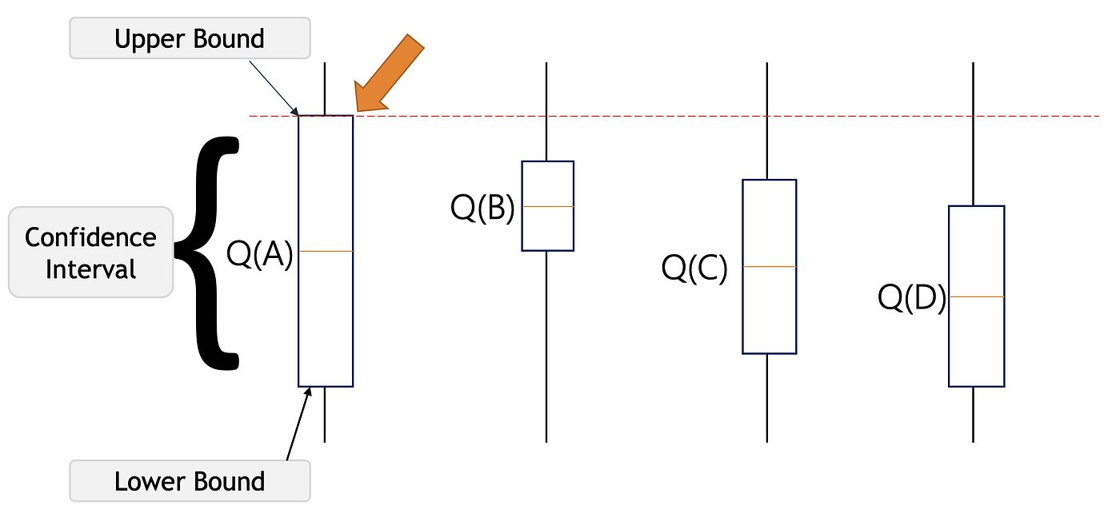
Upper-Confidence-Bound Action Selection
Confidence Level

Slide 37
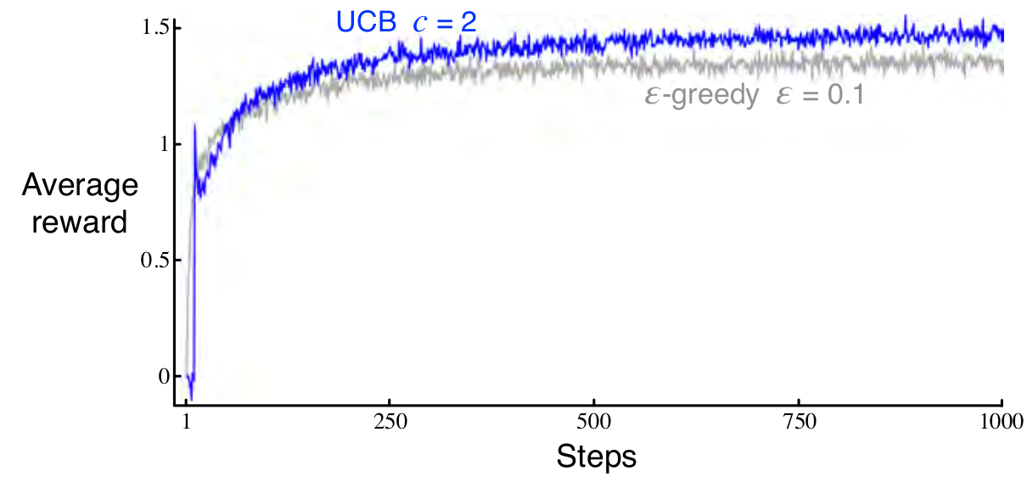
Upper-Confidence-Bound Action Selection
UCB often performs well, as shown here, but is more difficult than "-greedy to extend beyond bandits to the more general reinforcement learning settings

Slide 38
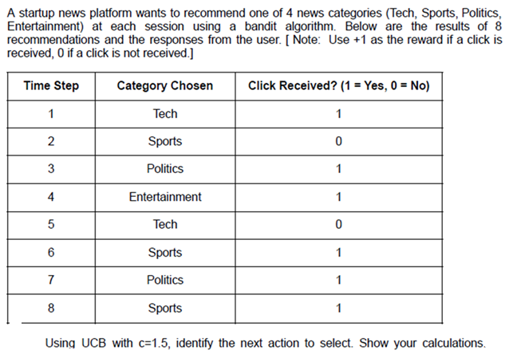
Upper-Confidence-Bound Example

Slide 39
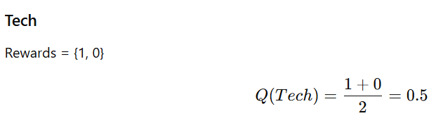
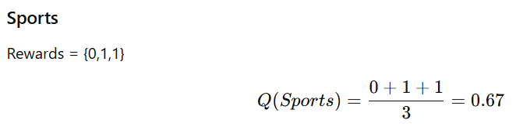
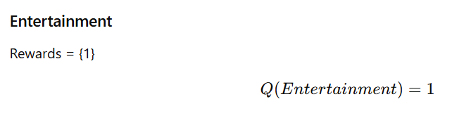
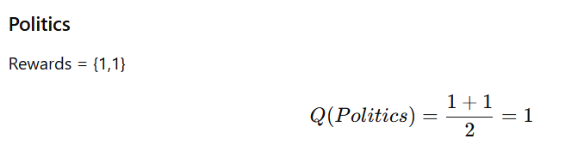
Upper-Confidence-Bound Example

Slide 40
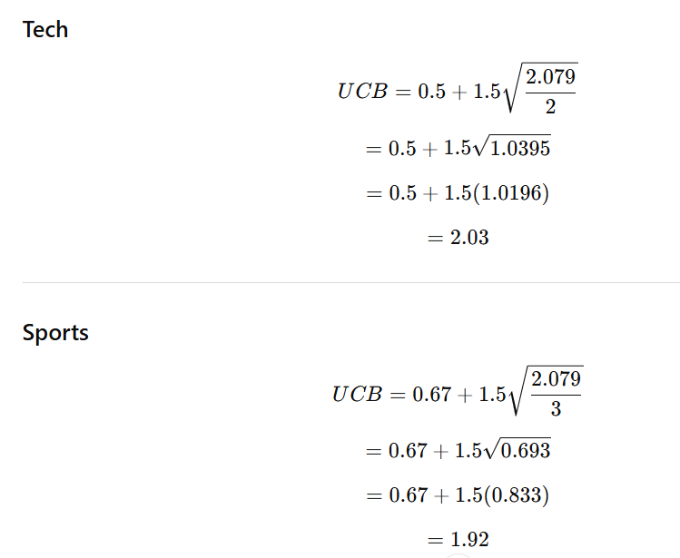
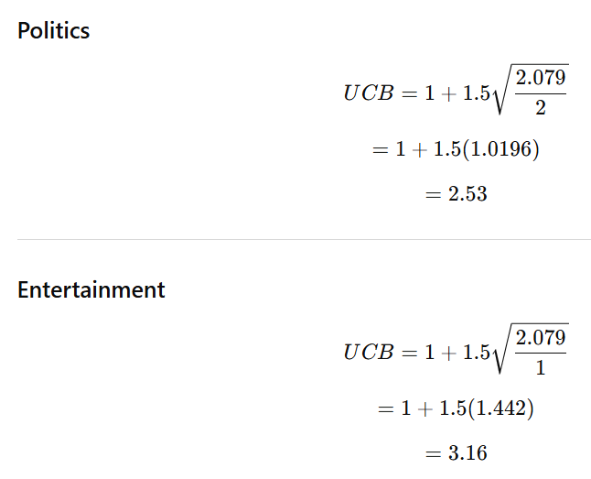
Upper-Confidence-Bound Example

Slide 41
Contextual Bandits
Agent observes additional information before choosing an action
At each time step t, the agent
Observes the context xt
Choose action at
Receive the reward Rt
Goal is to maximize the cumulative reward

Slide 42
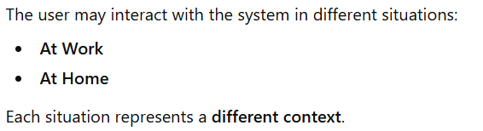
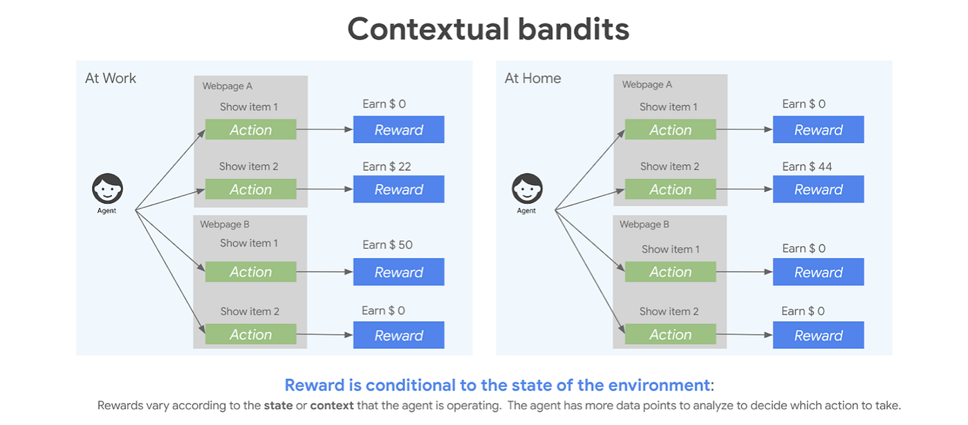
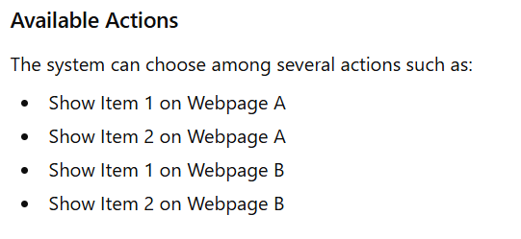
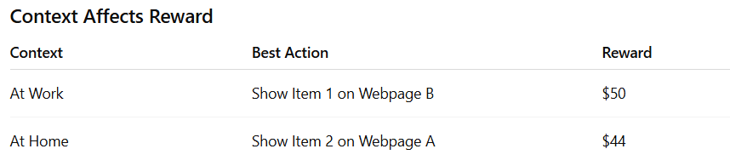
Contextual Bandits

Slide 43
Thank you

